Slide 1


CST8225-313
Family Expense
Tracker
Made by
Ryan Xu & Yizhen Xu

Slide 2
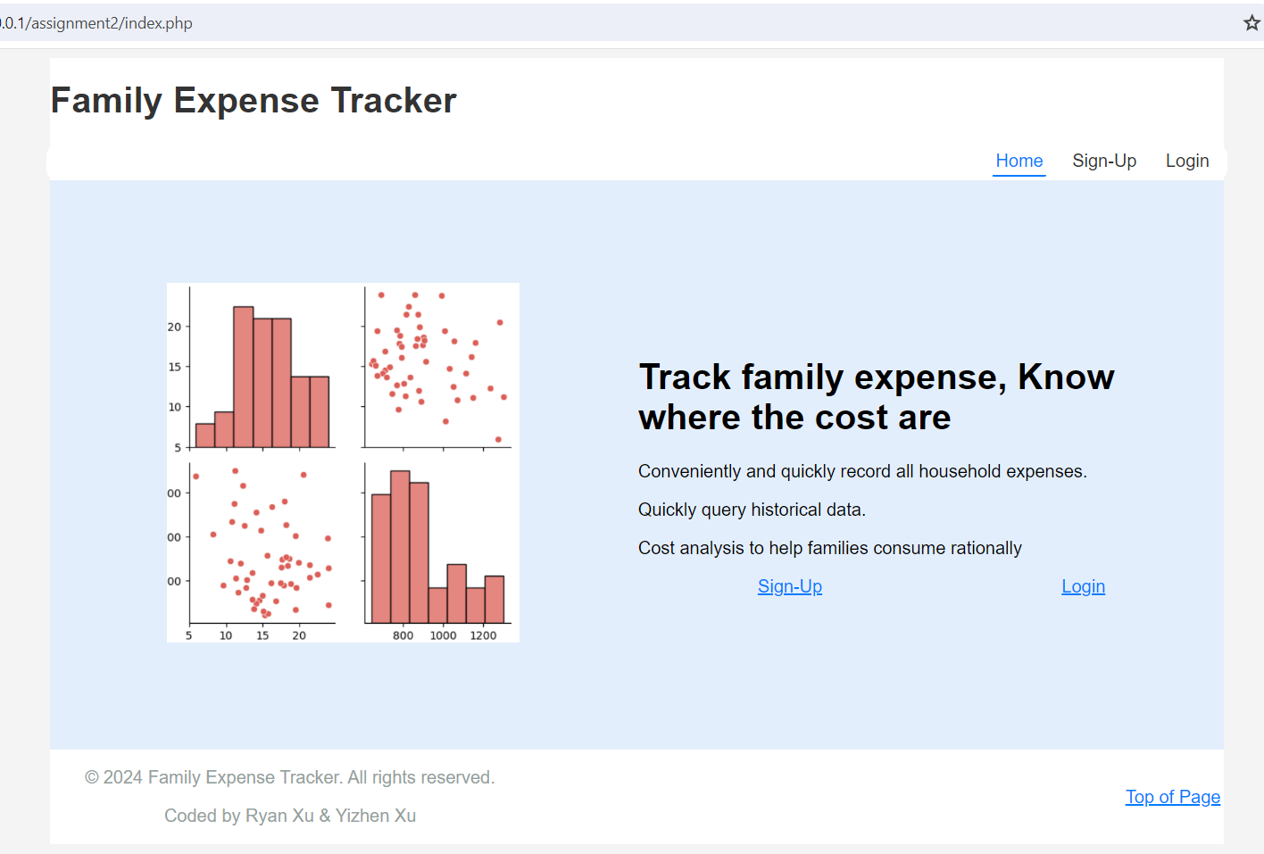
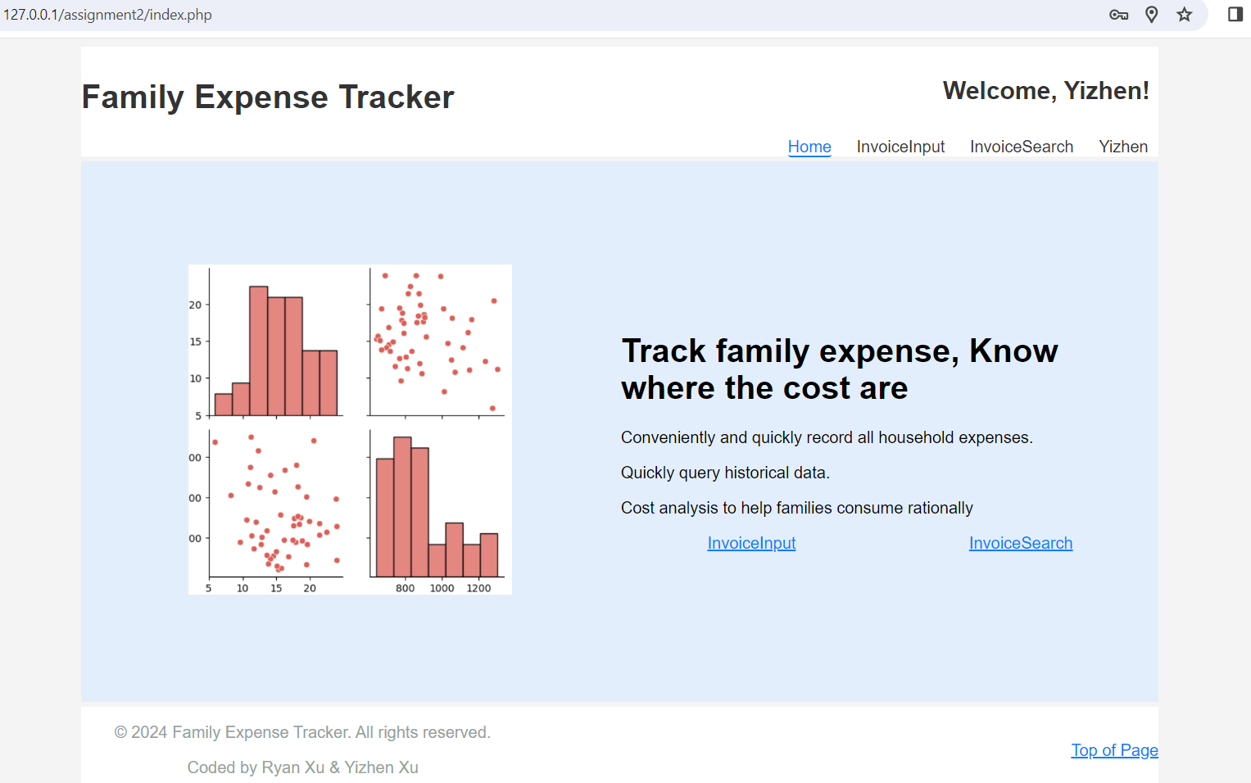
The Family Expense Tracker web application is designed to assist families in managing their expenses effectively. It provides a comprehensive platform for managing household expenses efficiently.
Homepage without login
Homepage with login
As shown in the figure, after the user logs in, the website‘s navigation options change. It changes from “Home, Sign-up, Login, Register” to “Home, InvoiceInput, InvoiceSearch, and User Account Information”.

Slide 3
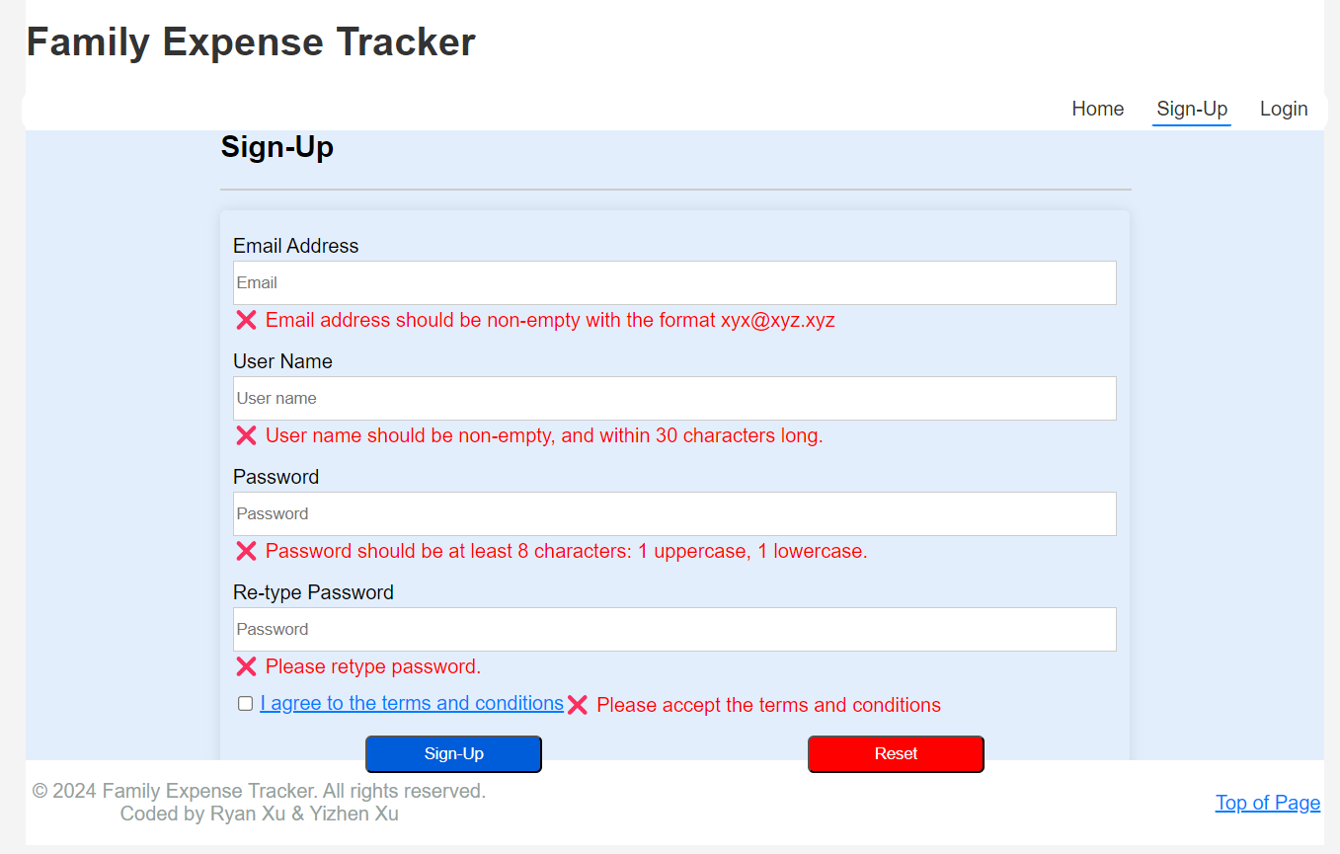
Sign-up Validation
When the user attempts to submit the sign up form then we will provide an inline feedback message and it will highlight the fields that are in error.
When a user enters valid data in a particular field, the error message associated with that field should be cleared, providing immediate feedback without affecting other non-valid data fields.

Slide 4
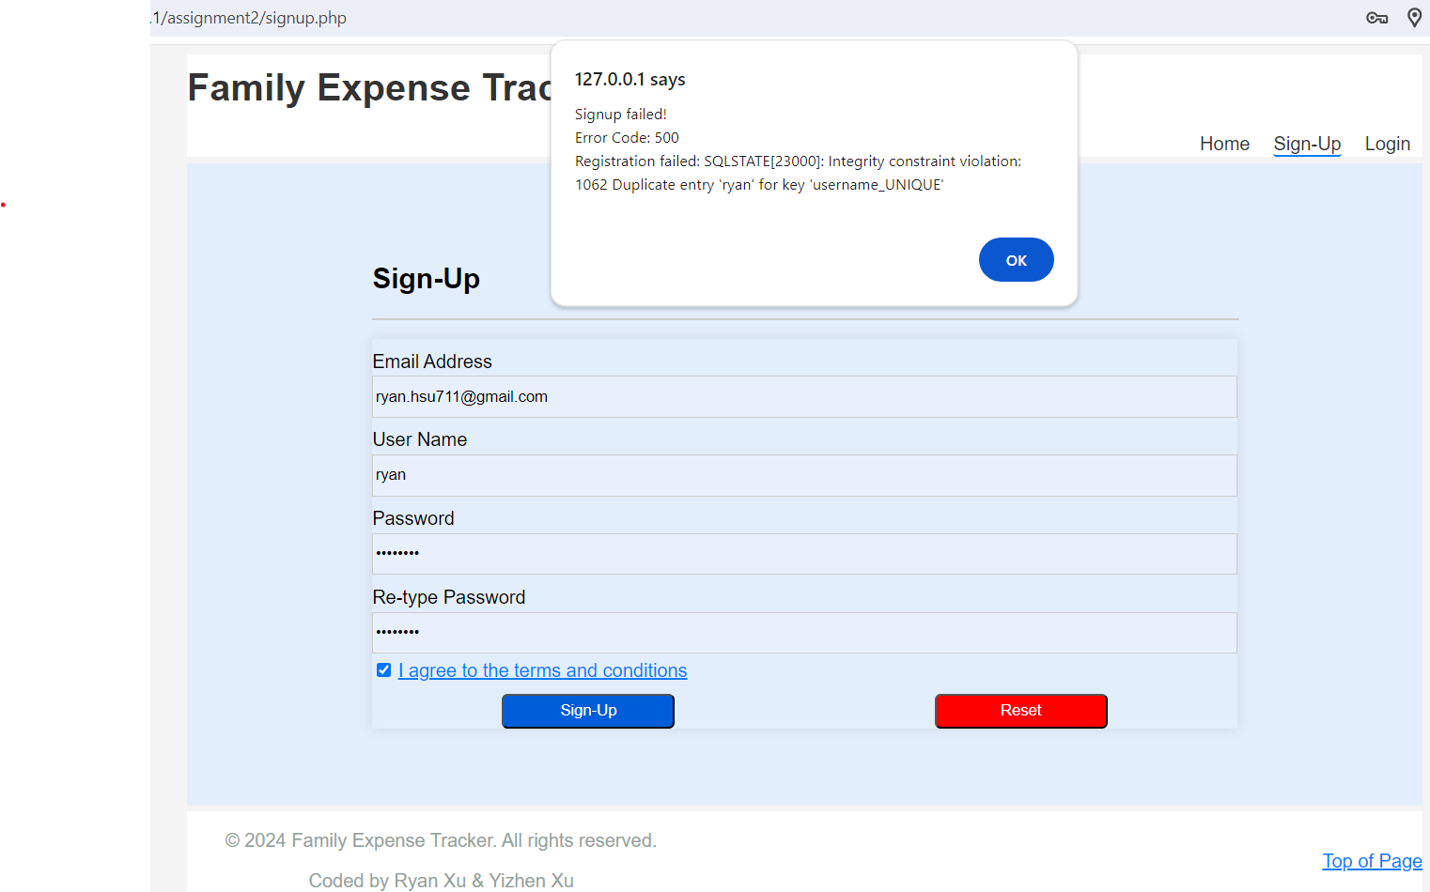
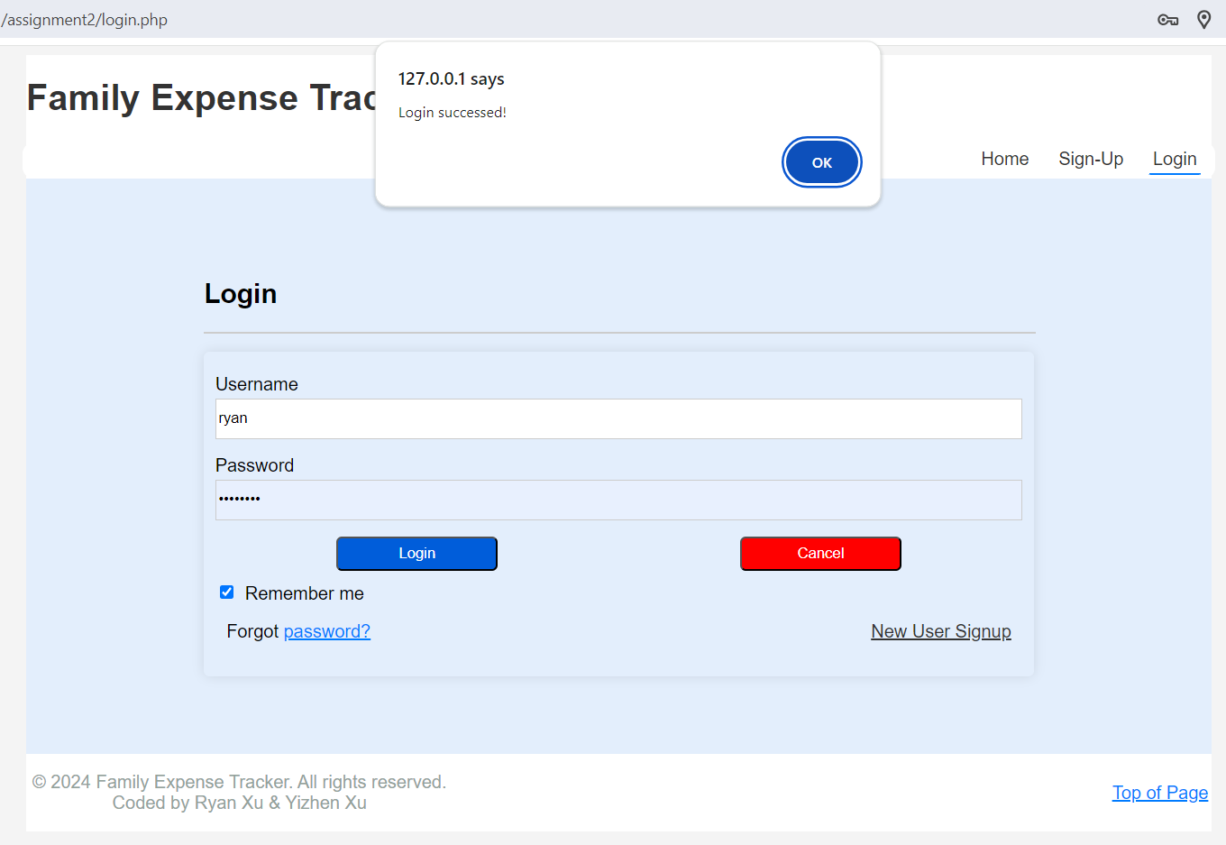
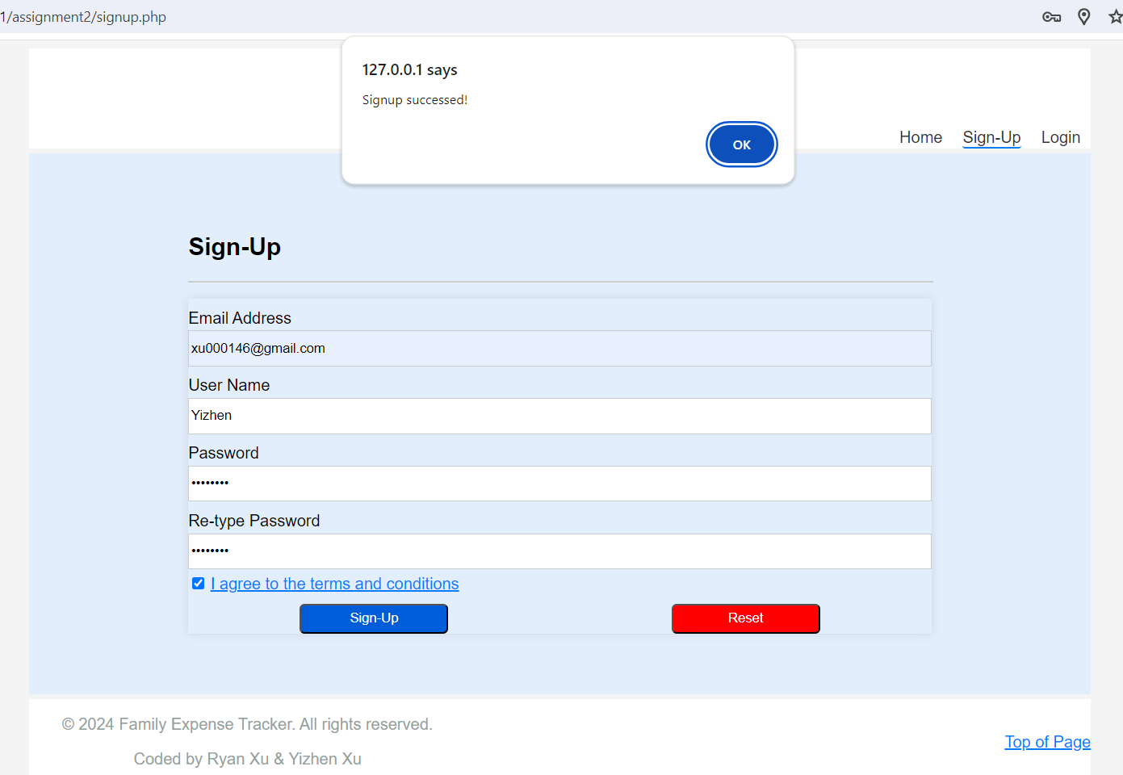
Sign-up failed
Regardless of whether the registration is successful or not, a pop-up alert message will appear on the webpage to remind new users.
After successful login, a popup notification will also appear.
Login succussed
Sign-up succussed

Slide 5
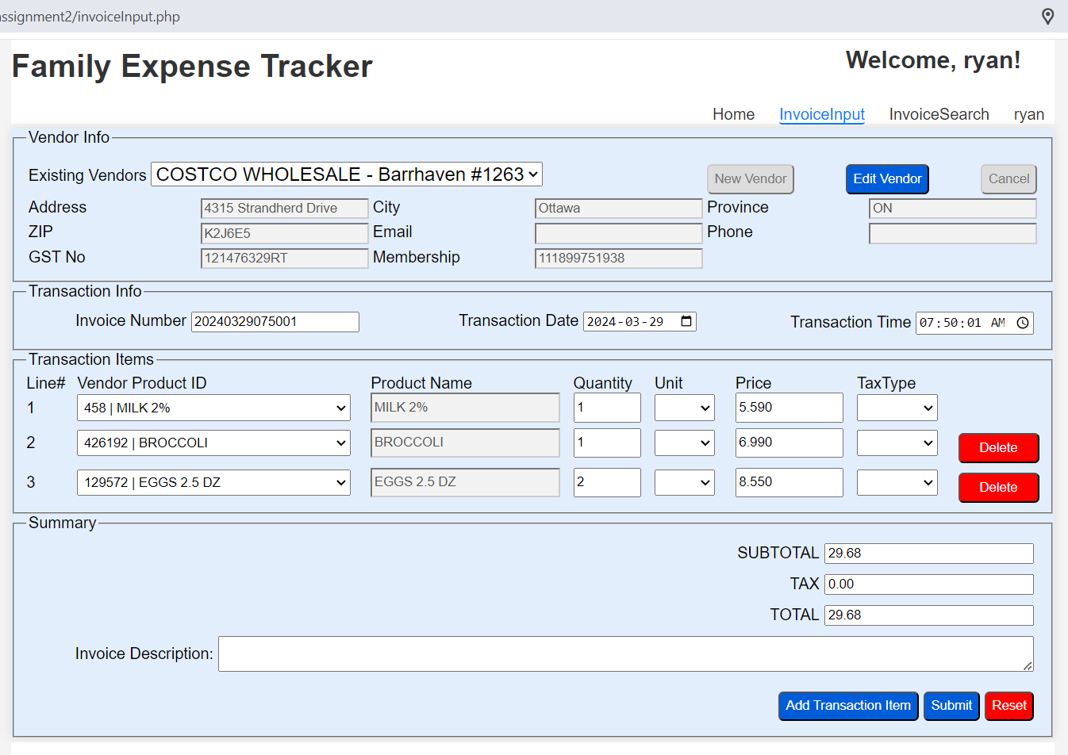
Invoice Input Page
After successful login, users can access the page of InvoiceInput and InvoiceSearch.
InvoiceInput page allows users to input invoice details for recording transactions, including vendor information, invoice details, transaction items, and totals.

Slide 6
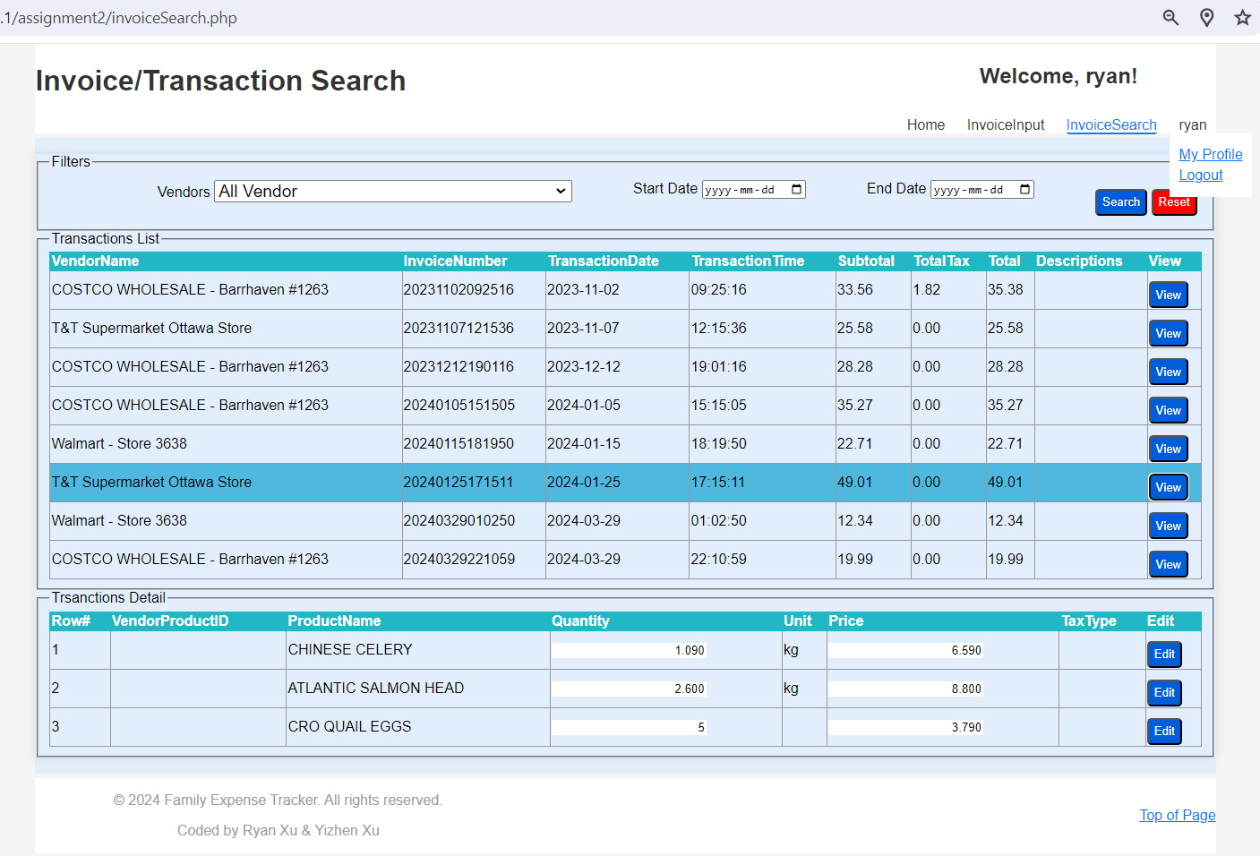
Invoice/Transaction Search Page
The Invoice/Transaction Search page enables users to filter and search for specific invoice details by vendor, date range, and view transaction lists and details.
On the far right of the navigation, Users could click on the username to access the profile modification interface.

Slide 7
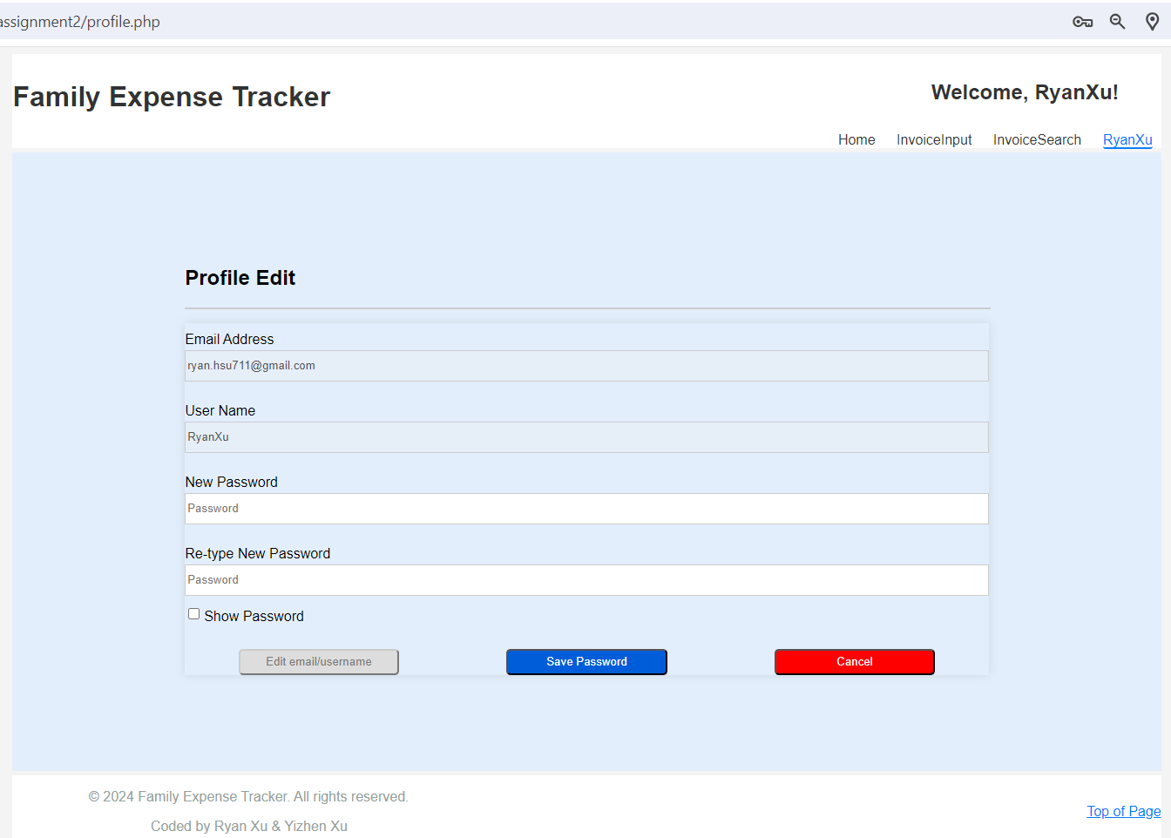
Profile Edit
Easily manage profile info and password on 'My Profile' page. Edit email/username, reset password, and navigate effortlessly.

